Slide 1
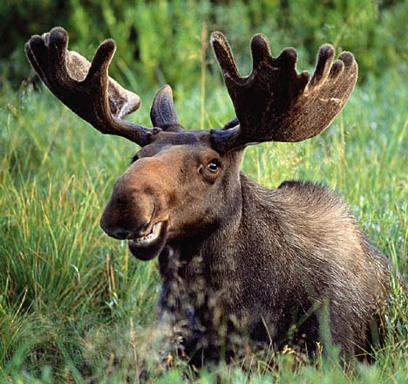
Call for a Superdark Moose in a Hidden Valley
Review of observed anomalies
Introduction to a new “Theory of Dark Matter”
Signatures at running or stalled colliders
Pauline Gagnon, Indiana University

Slide 2
Is there something beyond the Standard Model ? Yes, and dark matter is the best proof!
Slide from John Ellis

Slide 3
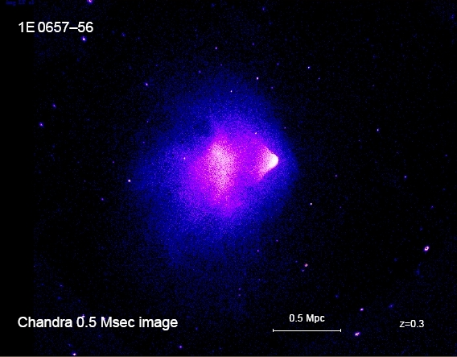
Proof that dark matter exists: the bullet cluster
Picture of two galaxy clusters hitting each other
What collides is the inter-galactic material (gas)
It heats up to 160x10^{6 o}C then emits X-rays
What we see here is the intensity of X-rays emission
Exposition time: 140 hours!
Picture is 1.6 light-year wide

Slide 4
Dark Matter is seen by Weak Gravitational Lensing
Same event seen by the Hubble telescope through gravitational lensing
Dark matter from each cluster passed over each other without interacting
Shows the contours of gravitational field caused by dark matter

Slide 5
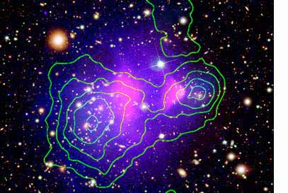
So dark matter is there but interacts very weakly
Inter-galactic gas clouds collided but the dark matter kept moving on
Center of gravity for visible matter and dark matter different

Slide 6
What is this dark matter? Could it explain many observed astrophysics anomalies?

Slide 7
Six observed, unexplained anomalies from astrophysics
High energy anomalies
PAMELA/HEAT
ATIC
WMAP haze
EGRET
Low energy anomalies
INTEGRAL
DAMA/LIBRA

Slide 8
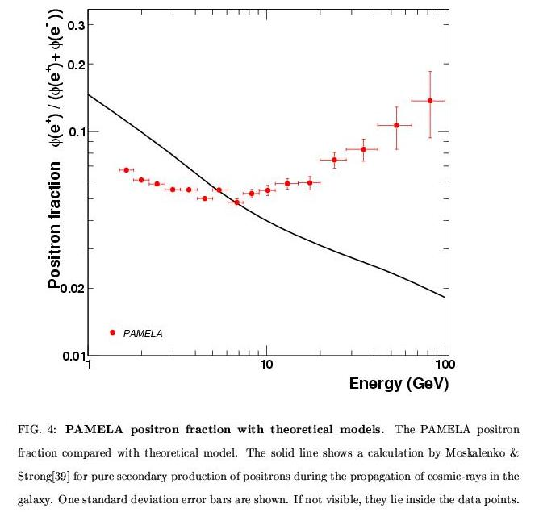
1. The PAMELA/HEAT anomaly: (PAMELA: Payload for Antimatter Exploration and Light-nuclei Astrophysics) - observed positron flux from cosmic rays φ_{e}+ / (φ _{e}+ + φ _{e}-) larger than expected; -first seen by HEAT; confirmed by PAMELA - no such excess seen for protons - could come from high energy cosmic ray interactions with interstellar medium; or could be due to nearby mature pulsars

Slide 9
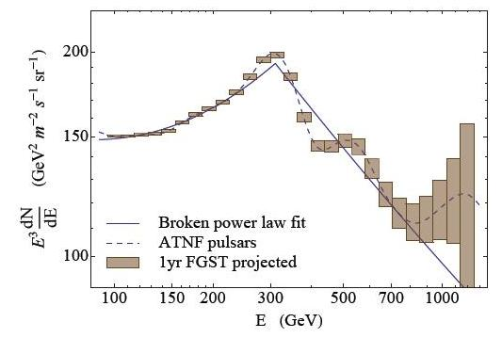
Pulsar or Dark Matter? Fermi may tell
Flux from pulsar characterized by steps
DM would give a power law spectrum
Malyshev, Cholis & Gelfand suggest Fermi could resolve this with one year of data (arXiv:0903.1310 )
ATNF: catalog of all known pulsars

Slide 10
2. The ATIC anomaly: (ATIC: Advanced Thin Ionization Calorimeter; balloon experiment above Antarctica) excess in cosmic ray electron flux at 300-800 GeV FERMI will soon release its data on this
ATIC AMS HEAT
BETS PPB-BETS emulsion chambers
power-law spectrum with solar modulation
Nature 456, 362-365 (2008)

Slide 11
3. EGRET:
γ-ray measurements in galactic center shows excess at 10-50 GeV
Same amount of data will be collected by FERMI in one year of data
FERMI will reach 25 times EGRET sensitivity
FERMI launched June 2008 – first data reported in Moriond

Slide 12
First results from Fermi: EGRET excess not confirmed

Slide 13
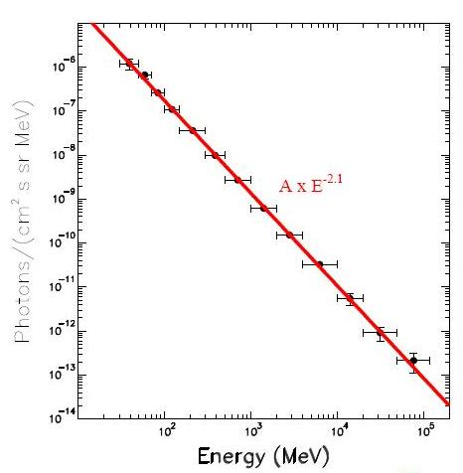
Fermi and EGRET agree at large latitudes
Χ²/dof = 0.27
EGRET and Fermi disagree on data from galaxy center
Agree on diffuse γ-ray background radiation (GBR) at large latitudes
GBR spectrum follows a simple power law
arXiv:0903.0165v1

Slide 14
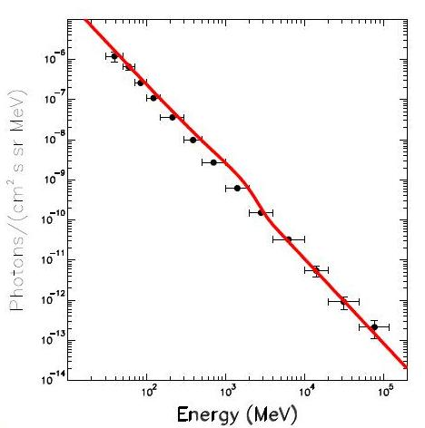
Dado and Dar argue ATIC is also wrong! arXiv:0903.0165v1
ATIC sees electron flux excess at 500-800 GeV coming from no particular direction
This should create diffuse γ-ray background radiation (GBR) at 0.8-2 GeV
This does not fit in with the EGRET GBR data
Χ²/dof = 14.6

Slide 15
4. WMAP haze at the Galactic Center:
(Wilkinson Microwave Anisotropy Probe)
a diffuse microwave excess observed by WMAP from the core of our galaxy but not coming from a particular source point
several distinct bands of diffuse radiation from the core of the galaxy spanning over 12 orders of magnitude in frequency.
high energy gamma ray could be due to synchrotron radiation coming from dark matter annihilation into e+ and e-

Slide 16
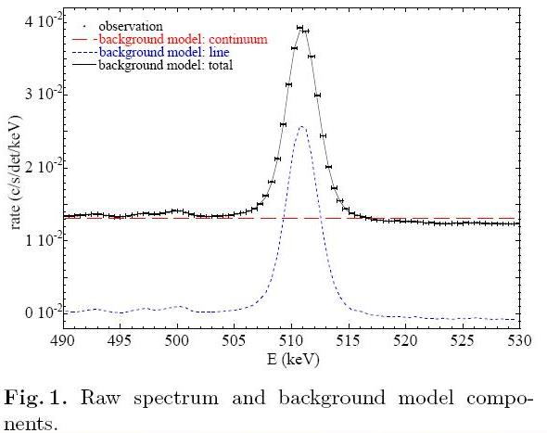
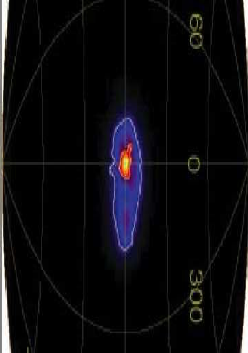
5. SPI/INTEGRAL: International Gamma-Ray Astrophysics Laboratory, Ge detector array
Observation of a 511 keV line from the galactic center –nothing from the galactic disk
First seen in 1970 at 473 ± 30 keV
Means large e+e- annihilation rate
Origin of galactic positrons unknown
Astrophysical sources could be neutron stars or black holes, radioactive nuclei from supernovae, cosmic ray interactions with the interstellar medium, pulsars etc.
arXiv:astro-ph/0309442
arXiv:astro-ph/0309484
Not a symmetric source

Slide 17
Excited dark matter to explain INTEGRAL (Finkbeiner and Weiner astro-ph/0702587)
If dark matter has a mass m_{χ} ~ 500 GeV, a dark matter particle travelling at a speed of 500 km/s carries kinetic energy > 511 keV
If dark matter χ has excited state, χ*, it can get excited by inelastic scattering when bumping into each other
χ* de-excite by emitting a e⁺e⁻ pair → source of positrons
The whole Milky Way is a vast reservoir of WIMP with kinetic energy ~ 10⁶⁰ erg
The 511 keV line radiates 5 x 10³⁶ erg/s
This has not made a dent even over the life span of the Universe!
All 511 keV emission comes from galactic center where dark matter is concentrated
Satisfies the relic abundance seen today

Slide 18
Diagrams for excited dark matter
Excited dark matter model also calls for a new light gauge boson in dark sector, φ
φ can also decay into e⁺e⁻
represents mixing

Slide 19
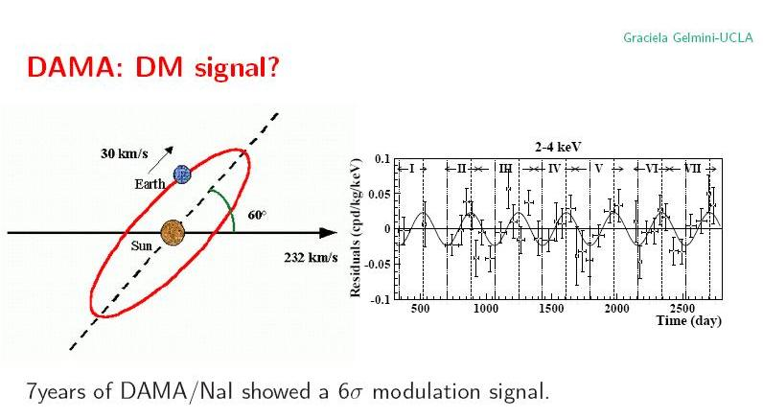
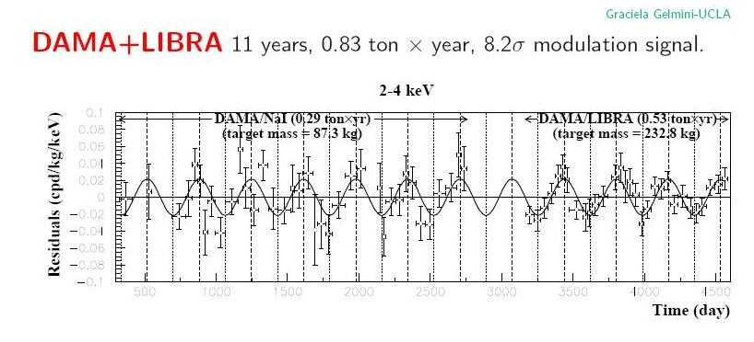
6. DAMA/LIBRA
NaI scintillator experiment in Gran Sasso
1st exp: DAMA: claims presence of Dark Matter particles in the galactic halo (7 yrs of data: 0.29 ton-year)
2nd exp: DAMA/LIBRA: 0.53 ton-year
8.2σ deviation for the cumulative exposure
No other source of modulation found
Other similar experiments have null results (EDELWEISS, EDMS)
arXiv:0804.2741

Slide 20
Inelastic dark matter scattering (see arXiv:0903.3941v1 for a nice summary)
χN→χ*N with δ= mχ*- mχ ~ 100 keV
For inelastic scattering to take place, the center-of-mass energy must exceed the mass splitting
Dark matter does not scatter for velocity below v_{min} ~ (2 δ/μ )^{1/2}
μ is the nucleon-dark matter reduced mass
This minimum velocity increases for small nucleus mass like iodine used by DAMA/LIBRA but would not be reached for Germanium used by CDMS or Edelweiss
Inelastic dark matter proposed by D. Tucker-Smith and N. Weiner Phys. Rev. D76 (2007) 083519

Slide 21
Could these anomalies have something in common?
Some of these anomalies might be flukes (EGRET for example)
Some have alternative astrophysical explanations
But they could also all have something to do with dark matter:
Dark matter annihilation gives rise to high energy e+ and e- to explain PAMELA and ATIC
WMAP: high energy gamma ray could be due to synchrotron radiation associated with these energetic e+ and e-
For DAMA to be compatible with other experiments null results, we need inelastic dark matter model (IDM)
For INTEGRAL, exciting dark matter is needed (XDM)
Both XDM and IDM require dark matter mass splitting

Slide 22
One size fits all?
That’s the goal of “A theory of Dark Matter”
Arkani-Hamed, Finkbeiner, Slatyer, Weiner arXiv:0810.0713v2
How to solve simultaneously high energy problems and low energy phenomena?
One way is to come up with two new particles:
One dark matter particle with a high mass to solve high energy anomalies
Add mass splitting to explain low energy anomalies
One low mass gauge boson comes naturally into play

Slide 23
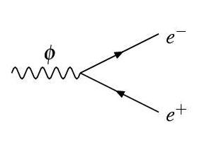
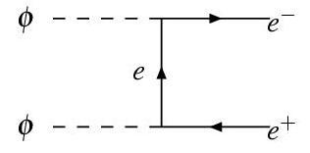
Explains both high energy and low energy anomalies
High energy:
A Weakly Interacting Massive Particle (WIMP) χ with m_{χ} ~ 500-800 GeV to explain high energy data
Dark matter χ could annihilate into a light boson φ:
χ χ → φφ
φ→ e+e- or μ+μ-
Provides a source of high energy positrons and electrons (ATIC, PAMELA)
These can also generate high energy photons by synchrotron radiation (WMAP)
φ could be so light that it can only decay into leptons
φ is a new force carrier with m_{φ} ~ 100 MeV-1 GeV
Low energy:
Impose that dark matter has excited states with small mass splitting for χ
Then the requirements of exciting dark matter needed for INTEGRAL and of inelastic dark matter for DAMA are both satisfied

Slide 24
A Theory of Dark Matter
They start from what’s needed to explain PAMELA and ATIC data and impose constraints such as satisfying the PAMELA rate and observed amounts of dark matter seen today
They argue that a dark matter particle χ , m_{χ}= 500-800 GeV cannot be the lightest supersymmetric particle (LSP)
Naturalness arguments bring in the need for a low mass new gauge boson: φ, m_{φ} ~ 1GeV
This allows them to get a Sommerfeld enhancement of the annihilation cross-section for χ χ → φφ needed to explain the relic abundance i.e. what is seen today

Slide 25
Sommerfeld enhancement:
b
r
Quantum mechanism needed to provide an enhancement (~ 100 times larger) for the dark matter annihilation rate. The usual WIMP cross-section is too weak to explain the current observations.
Classical analogy: cross-section for an object to hit a star of radius r is πr² but this cross-section will increase if gravity is present to be πb², where b is the distance-of-closest approach for capture.
Sommerfeld enhancement: arises when a particle has an attractive force carrier with a Compton wavelength > (α M_{DM})⁻¹, α: Dark Matter coupling.

Slide 26
A schematic view of Hidden Valley model
From M. Strassler, adapted by H. Lubati

Slide 27
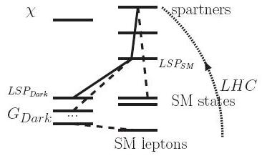
New picture
Two parallel worlds:
SM + SUSY
Dark sector also with SUSY_{dark}
At LHC, we can produce the highest SUSY states in SM sector
These will cascade down to LSP_{SM} but this is not the real LSP (lightest supersymmetric particle)
The LSP_{SM} is a messenger that can cross-over to the dark sector then decay into the true LSP, the LSP_{dark}
On the dark sector side, many χ states
The dark matter particle χ is not the LSP
φ is the lightest state
LSP_{dark} (our φ) is also a messenger and will decay into SM particles
Hidden Valley
dark sector
SM sector
arXiv:0810.0713v2
Only the LHC can produce the highest SUSY states, giving us an entry point to the dark sector through cascading and crossing-over

Slide 28
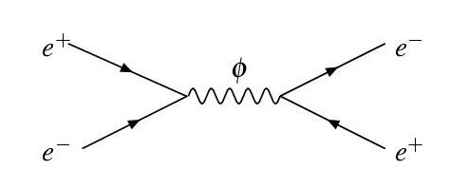
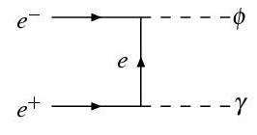
But why has φ not been observed yet?
If φ→ e+e- , then e+e-→φ is also possible
and so is e+e-→φ γ
Could look for it in Belle and BaBar data – in progress in Babar
Resonance too narrow to be seen in a scan at low energy
Better look for the extra photon
but this reduces σ by ε_{eff}²
A low cross-section would have prevented a discovery in earlier experiments with low energy and low luminosity

Slide 29
Production and decays in e⁺e⁻ colliders Essig, Schuster, Toro arXiv:0903.3941v1 SLAC, Stanford
Heavy dark sector gauge boson A’ produced off-shell, decays into other dark sector bosons W_{D} then into Standard Model leptons

Slide 30
Signature in ATLAS: different models predict “lepton jets”
Weiner et al., Lian-Tao et al.
χ χ → φφ
φ → e+e- or μ+μ-
m_{χ} ~ 500-800 GeV
mφ ~ 100 MeV - 1 GeV
Strassler et al.
gg → h → φφ
φ → e+e- or μ+μ-
m_{H} ~ 140 GeV
mφ ~ 100 MeV - 1 GeV
So φ has a large boost:
Very collimated or superimposed leptons
φ can also be long-lived
would give detached vertices
develop new trigger algorithms
φ → e+e- or φ → μ+μ-
Different energy deposits could point to the same track
Single track would have twice the normal # of high-threshold hits in TRT
If overlapping, several muon segments would point to the same track or no track
Rejected by current trigger algorithms

Slide 31
Cross-section in hadron collider: could be of order 1 pb for ε ~ 10⁻³
We expect ~200pb of data for the first year at LHC
Would be visible for ε > 10⁻³
Lian-Tao Wang et al, arXiv:0901.0283v1

Slide 32
Some typical dark decay chains Lian-Tao Wang et al. arXiv:0901.0283v1
γ’: dark sector gauge boson
(φ in previous slides)
Can decay directly into lepton pairs or into other dark gauge bosons w’, z’, h’
Gives rise to “leptons jets” containing 2-8 leptons

Slide 33
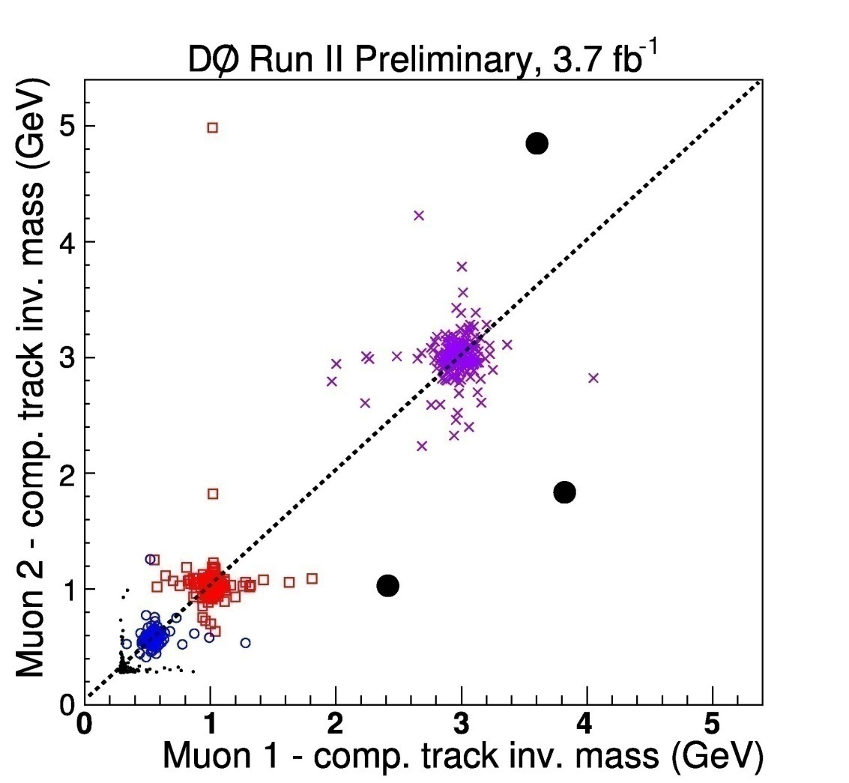
NMSSM search at D0 h →aa→ μμ μμ and h →aa→ μμ ττ
Looking for two pairs of isolated muons found in a narrow cone; a muons pair is defined as one muon plus one companion track found very near the muon

Slide 34
Limits on h→aa→μμ μμ from D0
Search similar to h→ φφ →μμ
Look for two isolated and collimated muons
They put a limit on
σ(pp →h+X) x BR(h→aa) x BR(a →μμ)² ~ 10 fb
if σ(pp →h+X) ~ 100 fb,
then BR(a →μμ) < 10% for BR(h→aa) = 100%

Slide 35
Preliminary look at lepton jets: muon pairs are found within δr < 0.2
δr
δφ
h → φφ → μμ μμ
Following predictions by Matt Strassler
m_{h} = 140 GeV
m_{φ} = 1 GeV
No problem finding μ and reconstructing φ
Closest muons give the right combo:
δr < 0.2
δr = √(δη² + δφ²)
Very preliminary
δη
m_{φ}

Slide 36
m_{φ} easily reconstructed for close muon pairs in ATLAS
Very preliminary
m_{φ}

Slide 37
Main problem right now in ATLAS: trigger
Events do not pass the ATLAS level 2 muon triggers
First trigger level is all hardware
Then level 2 and event filter are software algorithms
Need to develop new level 2 algorithms
About 90% of muons pass the first trigger level
Only ~10% accepted when muon spectrometer segments are matched with tracks from tracking system
Need to develop new algorithms that won’t flood the trigger system

Slide 38
Stay tune….
Clearly, much remains to be done on this
For sure, interesting results will soon be available:
From astrophysics experiments such as Fermi
From the Tevatron and LHC
From Babar/Belle
From g-2 experiments
And expect much more to be written on this topic!

Slide 39
But what about that moose?

Slide 40
Recipe for a SuperDark Moose in a Hidden Valley
The “Hidden Valley” bit because all this requires this parallel dark sector world called “Hidden Valley”
“Super” because this one is associated with SuperSymmetry
“Dark” since we’re dealing with dark matter…
A “moose” or “quiver” is a diagram used in gauge theory for its resemblance (!) to moose antlers…
?
=

Slide 41
Best way to catch a moose in ATLAS
Just call it! http://www.youtube.com/watch?v=29xM6VpXWl4

Slide 42
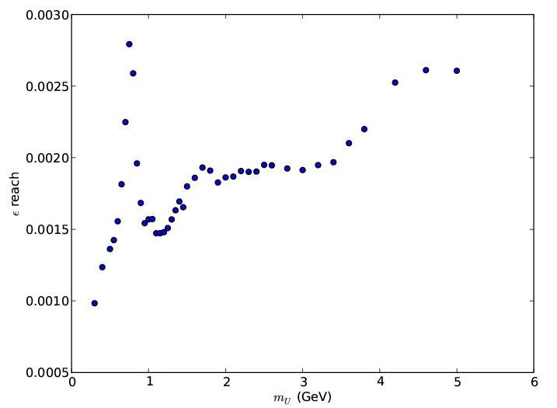
Reach on ε_{eff}² from BaBar ~ 10⁻³ preliminary work from Lian-Tao Wang
m_{φ} (GeV)

Slide 43
Decay length and track resolution Lian-Tao Wang et al. arXiv:0901.0283v1
With a typical boost: γ ~ O(10), displaced vertex if ε < 10⁻⁴
we would not see it in early data with 200 pb⁻¹
The opening angle between 2 leptons is δ(θ) ~ m_{γ’}/p_{T} < 0.1
This means Δ(η) ~ 50 mrad for θ ~ π/2
ATLAS can resolve 2 tracks with about 1 mrad separation:
Pixel resolution: 100 microns; last layer at 12 cm
At higher rapidity, even easier
Could be seen in early data for ε ≥ 10⁻³

